Slide 1
STEPHANOS OF ALEXANDRIA A FAMOUS BYZANTINE SCHOLAR (6th-7th centuries)
MARIA K. PAPATHANASSIOU
PROF. EMERIT. DEPT OF MATHEMATICS
NATIONAL AND KAPODISTRIAN UNIVERSITY OF ATHENS

Slide 2
On Stephanos of Alexandria or Stephanos of Athens
Stephanos of Alexandria is a prominent Byzantine scholar at the turn of the 6th to the 7th centuries, known as a commentator on Plato and Aristotle.
He is also attributed with astronomical, astrological, alchemical, and medical works under the names “Stephanos the philosopher” or “Stephanos the Athenian philosopher,” and designated as “practical philosopher” and “philosopher and œcumenical teacher.”
Stephanos of Athens should be identified with Stephanos of Alexandria. The designation “Alexandrian” does not indicate his native city, but that, when he settled in Constantinople, he came from Alexandria. He was most likely born in Athens, but his time in Alexandria was decisive for the course of his studies and his professional future.
He was a renowned scholar in Alexandria, interested in philosophy, medicine, and science, before moving ca. 617 to Constantinople, where the emperor Heraclius (610-641) invited him to teach the Quadrivium.

Slide 3
Commentaries on Aristotle (1)
We know his commentaries on Aristotle’s De interpretatione and De anima III, whereas those on Kategorien, Analytica, Sophistici elenchoi, and De caelo are known only indirectly.
On De anima III: The commentary is divided into theoretical and practical parts.
Stephanos cites earlier and later commentators and examines their opinions.
He says that Aristotle poses three questions and differentiates between the rational soul and sensation.
He introduces Neoplatonic argumentation regarding the individual Nous into the Aristotelian theory.
He acknowledges the authority of Christian doctrine and the Bible, but he does not revise the ancient text on those grounds.
He refers to Aristotle’s eternity of the Cosmos, the existence of the fifth element, the pre-existence of the human soul, and the rationality of the human body without attempting to reconcile them.

Slide 4
Commentaries on Aristotle (2)
On Interpretation:
The commentary is divided into parts, which are further divided into lectures.
Given the title’s phrase “according to Stephanos’s oral teaching,” we can deduce that the work is based on his students’ notes.
R. Vancourt has shown that this commentary is based on Ammonius and that its division reflects the method characteristic of the School of Olympiodorus, as seen in the commentaries of Olympiodorus on Aristotle (On Meteorology, Categories) and on Porphyrius’s Introduction, as well as in the commentaries of Elias and David on Aristotle.

Slide 5
Commentaries on Hippocrates
Commentaries on Hippocrates’s Prognostics, Aphorismes, Explanation of Galen’s therapeutics, On Theophilos’s on the difference of fevers, On fractures, On Dioscurides, and others.
On Prognostics is based on Stephanos’s oral teaching and is organized using the same method as the commentaries on Aristotle. Each part begins with a general theoretical discussion, followed by the necessary explanation of selected words and phrases.
General characteristics of Alexandrian philosophy in the medical commentaries of Stephanos of Athens: God’s foreknowledge; the mistake in the art as it pertains to changing things; the aim of philosophy as the assimilation of man to God; the four causes; the real number of combinations of two pairs of things; and the corporeality and incorporeality of heaven.
Stephanos discusses the length of the tropical year and refers to Aristotle’s Meteorology and Plato’s Timaeus.

Slide 6
Commentaries on Ptolemy’s Handy tables edited by Theon
The astronomical work of Stephanos, the “Commentary on Ptolemy’s Handy Tables edited by Theon,” is very important because it was written a few years before the Arab occupation of Alexandria. Actually, it is the last astronomical commentary of the early Byzantine period, based solely on the Greek astronomical tradition.
The astronomical data in the work indicate the place and time of its composition: All examples are given for the geographical coordinates of Constantinople in the years 617-619, namely during the reign of Emperor Herakleios.
O. Neugebauer showed that Stephanos has reversed the order of some chapters relative to those in Ptolemy and Theon, thereby improving upon its predecessors.

Slide 7
Astrology and Alchemy in Late Antiquity and Early Byzantine times (1)
Astrology was the most sophisticated divinatory art because of its philosophical foundation and the astronomical techniques required to cast a horoscope.
A large number of horoscopes cast by well-known astrologers during this period are preserved in papyri and later Byzantine manuscripts.
An ancient commentary on Paul of Alexandria’s astrological work (ca. 378) comes from a series of lectures delivered in Alexandria during May-June of the year 564 either by Olympiodorus or one of his disciples who taught mathematics or astrology. Consequently, in the sixth century, astrology could still be an important part of the Quadrivium.
Consequently, Stephanos of Alexandria must have studied astrology in Alexandria.

Slide 8
Astrology and Alchemy in Late Antiquity and Early Byzantine times (2)
Christian emperors were interested in consulting astrologers for both their personal and state affairs. Emperor Manuel Komnenos (1143-1180) defended astrology in a letter addressed to a monk of the Pantokrator monastery. One of his arguments was that Constantine the Great (307-337), after consulting the best astrologer of his time, Valens, waited fourteen years for the most favorable date for the inauguration (“dedicatio”) of Constantinople.
The flourishing of astrology during the reigns of later Byzantine dynasties and the considerable number of astrological manuscripts in the private libraries of state and church officers suggest that many Byzantine scholars and intellectuals had reconciled their Christian faith with astrology.
ALCHEMY is a different case because its techniques, closely related to those of the goldsmiths, had many applications to the art of jewelry-making and the luxurious decoration of palaces and churches. ‘Umāra ibn-Ḥamza (d. 814/815), the ambassador of caliph al-Manṣūr (754-775) to the Byzantine court, reveals the alchemical interests of Emperor Constantine V Kopronymos (741-775).

Slide 9
On the Great and Sacred Art of Making Gold
The manuscript tradition of the work indicates that it was greatly appreciated: it survives in 53 MSS (47 in Greek, 2 in Greek with a Latin translation, 4 in Latin); with the exception of 6 MSS produced in the 11th -15th centuries, the rest were copied in the 16th -19th centuries.
It influenced the poet-alchemists Heliodoros, Theophrastos, Hierotheos, and Archelaos, as is evident from several passages in their texts.
In Arabic tradition, the name and work of Stephanos (Isṭafānūs) are associated with Emperor Heraclius (Hiraql).
In the Latin alchemical tradition, the author of the Rosarium Philosophicum (mid-14th-century) cites and comments on Stephanos.
Stephanos’s work is included in Dominicus Pizimentius’ 1573 printed edition of Greek alchemists in Latin translation, as well as in later editions.
One-tenth of the books owned by Isaac Newton (1643–1727) were alchemical, and 9 of 84 titles recorded in his autograph manuscript De scriptoribus chemicis refer to the Latin translation of works by Greek alchemists, including Stephanos.

Slide 10
On the Great and Sacred Art of Making Gold
It is a series of 9 lectures that comment on selected passages from earlier alchemical texts.
Their loose structure reflects Stephanos’s effort to synthesize ideas from a wide array of disciplines into a logical sequence and fashion them into a whole. He says, this is exactly the philosopher’s research method.
The lack of clarity and logical sequence in the combination of ideas that also characterizes Stephanos’ Commentary on Aristotle’s De anima III, provides an additional argument in favor of Stephanos’ authorship of the alchemical work.
Stephanos dislikes the whole chemical apparatus and polemicizes against those who pursue the art of making gold to become rich.
Stephanos’s principles of “practical philosophy” are deeply rooted in Neoplatonism, especially in Damascius’ De principiis. These principles concern the structure and transformations of matter, the One and the Many in the world, and his theoretical approach to the philosophers’ riddle, i.e., the secret name of the philosophers’ stone.

Slide 11
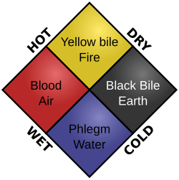
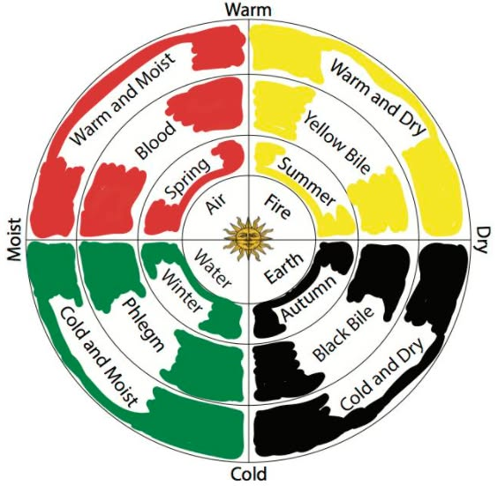
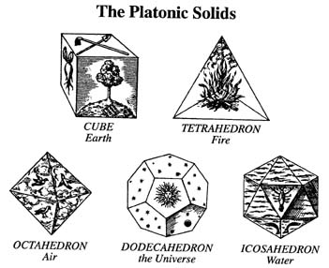
On the Great and Sacred Art of Making Gold
Blood, composed of air, is warm and humid and resembles quicksilver.
Yellow bile, composed of fire, is warm and dry and resembles copper.
Black bile, composed of earth, is dry and cold and resembles the dross of both [quicksilver and copper].
Phlegm, composed of water, is cold and humid and resembles the vapors of a watery solution of gold, which are the souls of copper.

Slide 12
On the Great and Sacred Art of Making Gold
The “mystery of the philosophers” is carried out through the seven planets; the philosophers call it the “Egg of the philosophers, which is not laid by a bird.” Stephanos means the cosmogonic Egg of Greek philosophy, which, according to Orphic doctrine, “is older not only than the bird, but also older than anything in the world.” This Egg is a dynamic image of the All, and should be identified with the Stone of the philosophers.
Earth ➢ white ➢from the feet to the knees.
Water ➢ far-shining and translucent ➢ from the knees to the navel.
Fire ➢ fiery ➢ from the navel to the heart.
Air ➢ saffron ➢ from the heart to the neck.
The head regulates the changes in humors in the human body exactly as the alternation of seasons regulates the changes of juices in nature.
The changes of the four primary elements into one another and the occurrence of natural phenomena are similar to what takes place in a chemical apparatus: the cover of the earthen pot looks like the sky that covers the earth; many changes occur in both the sky and the chemical apparatus, as putrefaction and the dross of metals change by exhalation.

Slide 13
On the Great and Sacred Art of Making Gold
Fire-quicksilver is united with water through earth-dross, as blood is united with phlegm through black bile; this is the first key and a separation of the humid from the dry, i.e., a separation of the souls of copper from the bodies, namely, quicksilver.
Earth-dross is united with air-gold through fire-quicksilver, just as black bile is united with yellow bile through blood; this is the second key, the making of a mound of putrefied [substance], so that the dross is united with fire-quicksilver through sulfureous [divine] water.
Air-gold is united with earth-dross by water, just as yellow bile is united with black bile through phlegm. This is the third key, a union of air with earth, a resolution by putrefaction and boiling, i.e., by the seven conversions, so that it becomes water and all is united in cinnabar.

Slide 14
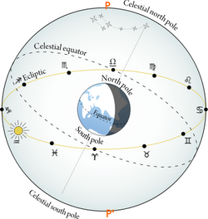
On the Great and Sacred Art of Making Gold
Stephanos draws between the 4 primary elements and the 4 fixed points of the Sun’s annual path in the Zodiac: the vernal and autumnal equinoxes, and the winter and summer solstices.
He names the 12 zodiacal signs “towers” and thus describes the sacred art of making gold as having 12 towers and 12 signs, divided into 4 groups (seasons) of 3 towers (signs) each:
The vernal equinox and the signs-towers Aries, Taurus, and Gemini correspond to air.
The summer solstice and the signs Cancer, Leo, and Virgo correspond to fire.
The fall equinox and the signs Libra, Scorpio, and Sagittarius correspond to water.
The winter solstice and the signs Capricorn, Aquarius, and Pisces correspond to earth.

Slide 15
An astronomical phenomenon recorded (1)
Again the [planet] of Venus attains the Persian dawn and precedes the rays of the Sun;
again the [planet] of Mercury, under the rays of the Sun, is found in the subsequent [Zodiacal signs];
again the [planet] of Saturn is faintly discernible due to the steepness of its height;
again the [planet] of Mars is preparing for the burning cut;
towards these [planets] comes the Moon dressed as a bride [and] takes up the towed ships of the nine parts; by means [of the Moon] the alloy that is in the process of mixing itself does so to perfection.

Slide 16
An astronomical phenomenon recorded (2)
The whole operation comprises three [bodies/ elements/ metals] and exhibits the tetrasomia [= the four bodies] as a fourth, proceeding in an orderly manner. And they [= the bodies/ planets] run about to serve the most pure one [= Moon], so that by means of the vigorous [conjunctions?] they spur [themselves?] on toward the rays of the Sun, so that what [comes] from something perfect and is perfect be combined with [other] perfect [things].
The order of the planets in the mentioned alignment:
Mercury, Sun [both below the horizon]
Venus, Saturn, Mars, Moon [above the horizon]

Slide 17
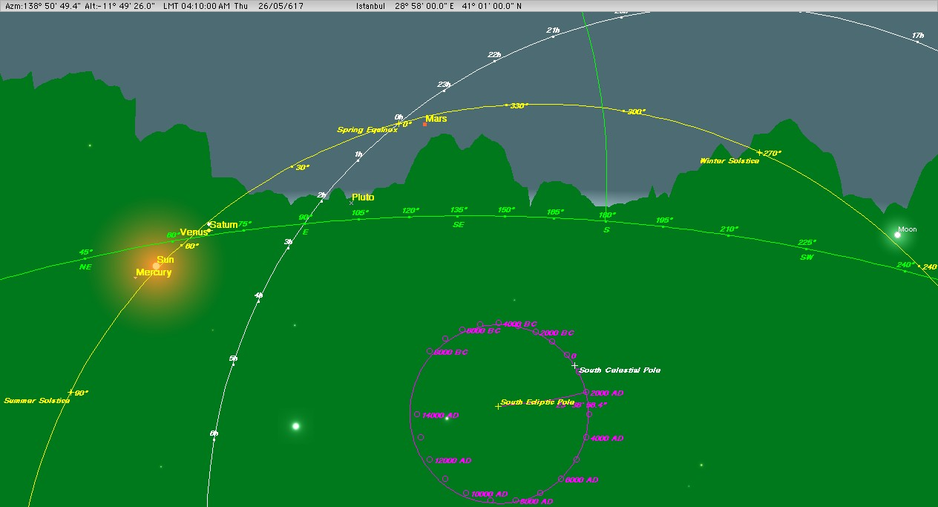
Constantinople, 26 May 617, 4:10 am

Slide 18
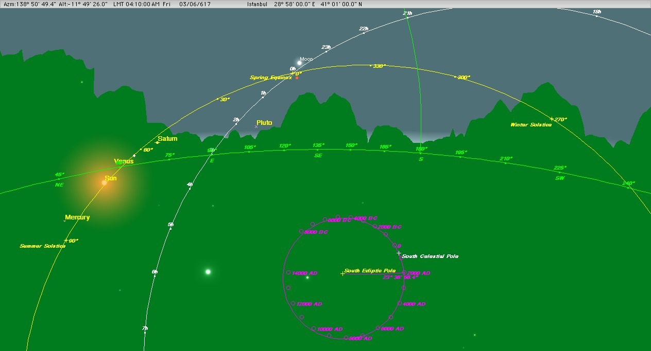
Constantinople, 3 June 617, 4:10 am

Slide 19
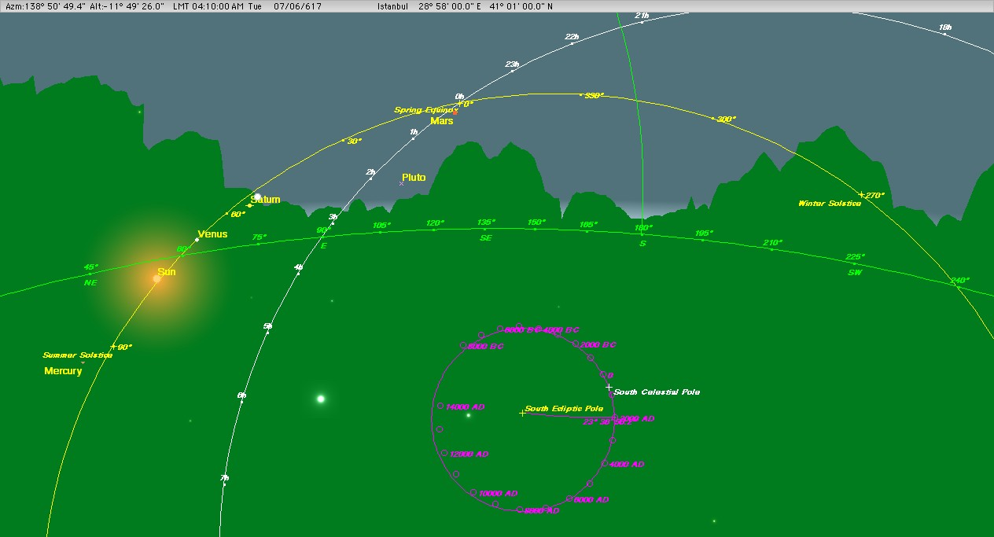
Constantinople, 7 June 617, 4:10 am

Slide 20
The astrological treatise (1)
In the first part, the author refers to “the books of ancient wise men, books on scientific initiation through astronomy,” and explains the “introductory method” to them. Among other things, he also tries to offer his readers a clear understanding “through the eventual and possible configuration of the stars,” which God gave us to use “like a prophetess.” The author piously points out that all natural phenomena and changes observed in the world, as well as all political and social events, even a man’s talents and status in society, depend on God. In other words, everything depends on the “will and energy of the Creator, God of all, to whom alone belongs the creative causality.” God uses the stars and their motions as simple instruments, even though he could achieve his aims without the stars. The author asserts firmly that “perfect and true knowledge belongs to God, while men, making conjectures on the basis of the elements and the stars, in part know and in part predict.” Consequently, both the extent of our knowledge and the accuracy of our predictions through the position of the stars are always restricted and subject to failure.
Stephanos’s lectures On making gold prove his great piety, as they begin and end with prayers greatly influenced by the works of the Early Christian Fathers

Slide 21
The astrological treatise (2)
In the second part, the author explains why and when he cast the horoscope of Islam, and then offers a general analysis of it based on known astrological principles. He says that he was in the school’s small garden with his students when Epiphanios, a merchant who had just arrived from Arabia Felix, visited him. Upon entering, Epiphanios requested that Stephanos order one of his students to suspend the astrolabe and determine the ascending degree of the ecliptic, the planetary positions, and the cardinal points of the horoscope, because of the importance of the news Epiphanios was about to report. Stephanos ordered “his Sophronios” to do so. “While Sophronios was busy suspending the astrolabe and calculating the hour, Epiphanios began his narrative” regarding the appearance and activity of Muḥammad in Arabia.
The third part includes predictions about the events that will take place “during the dominion of this nation”, both in general terms, following the characteristics of the planets found in each of the horoscope’s houses, and specifically during the reign of each of Islam’s future caliphs.

Slide 22
Astrological treatise ➢ Alchemical work
The author reminds his student Timotheos and other auditors of the content of his lectures and his teaching method :
“I have elucidated everything I taught you and your fellow-listeners, my students, by circumscribing it within the limits of philosophy and clarifying it through theories [so that it be] accurate and truthful not through persuasion [wrought] by the elegance of words but through natural and unexceptionable sequence; [I mean] the Platonic method of reasoning, Aristotelian physiology, geometric deliberations, arithmetic proportions, musical repetitions, (the alchemical allegories and impenetrable processes of thought, the astronomical critical points in human life and the notorious astrological predictions,) the Ptolemaic… Syntaxeis and his practical enchantments.”
“Not only these and [other] such animals have had such a birth, but also many other forms are produced by putrefaction, according to the differences of species and the position of the stars, such as the metals, for example, gold, silver, copper, iron, and lead; the different stones; and whatever is like them. Those of us who remember understand [the process of their birth] well.”

Slide 23
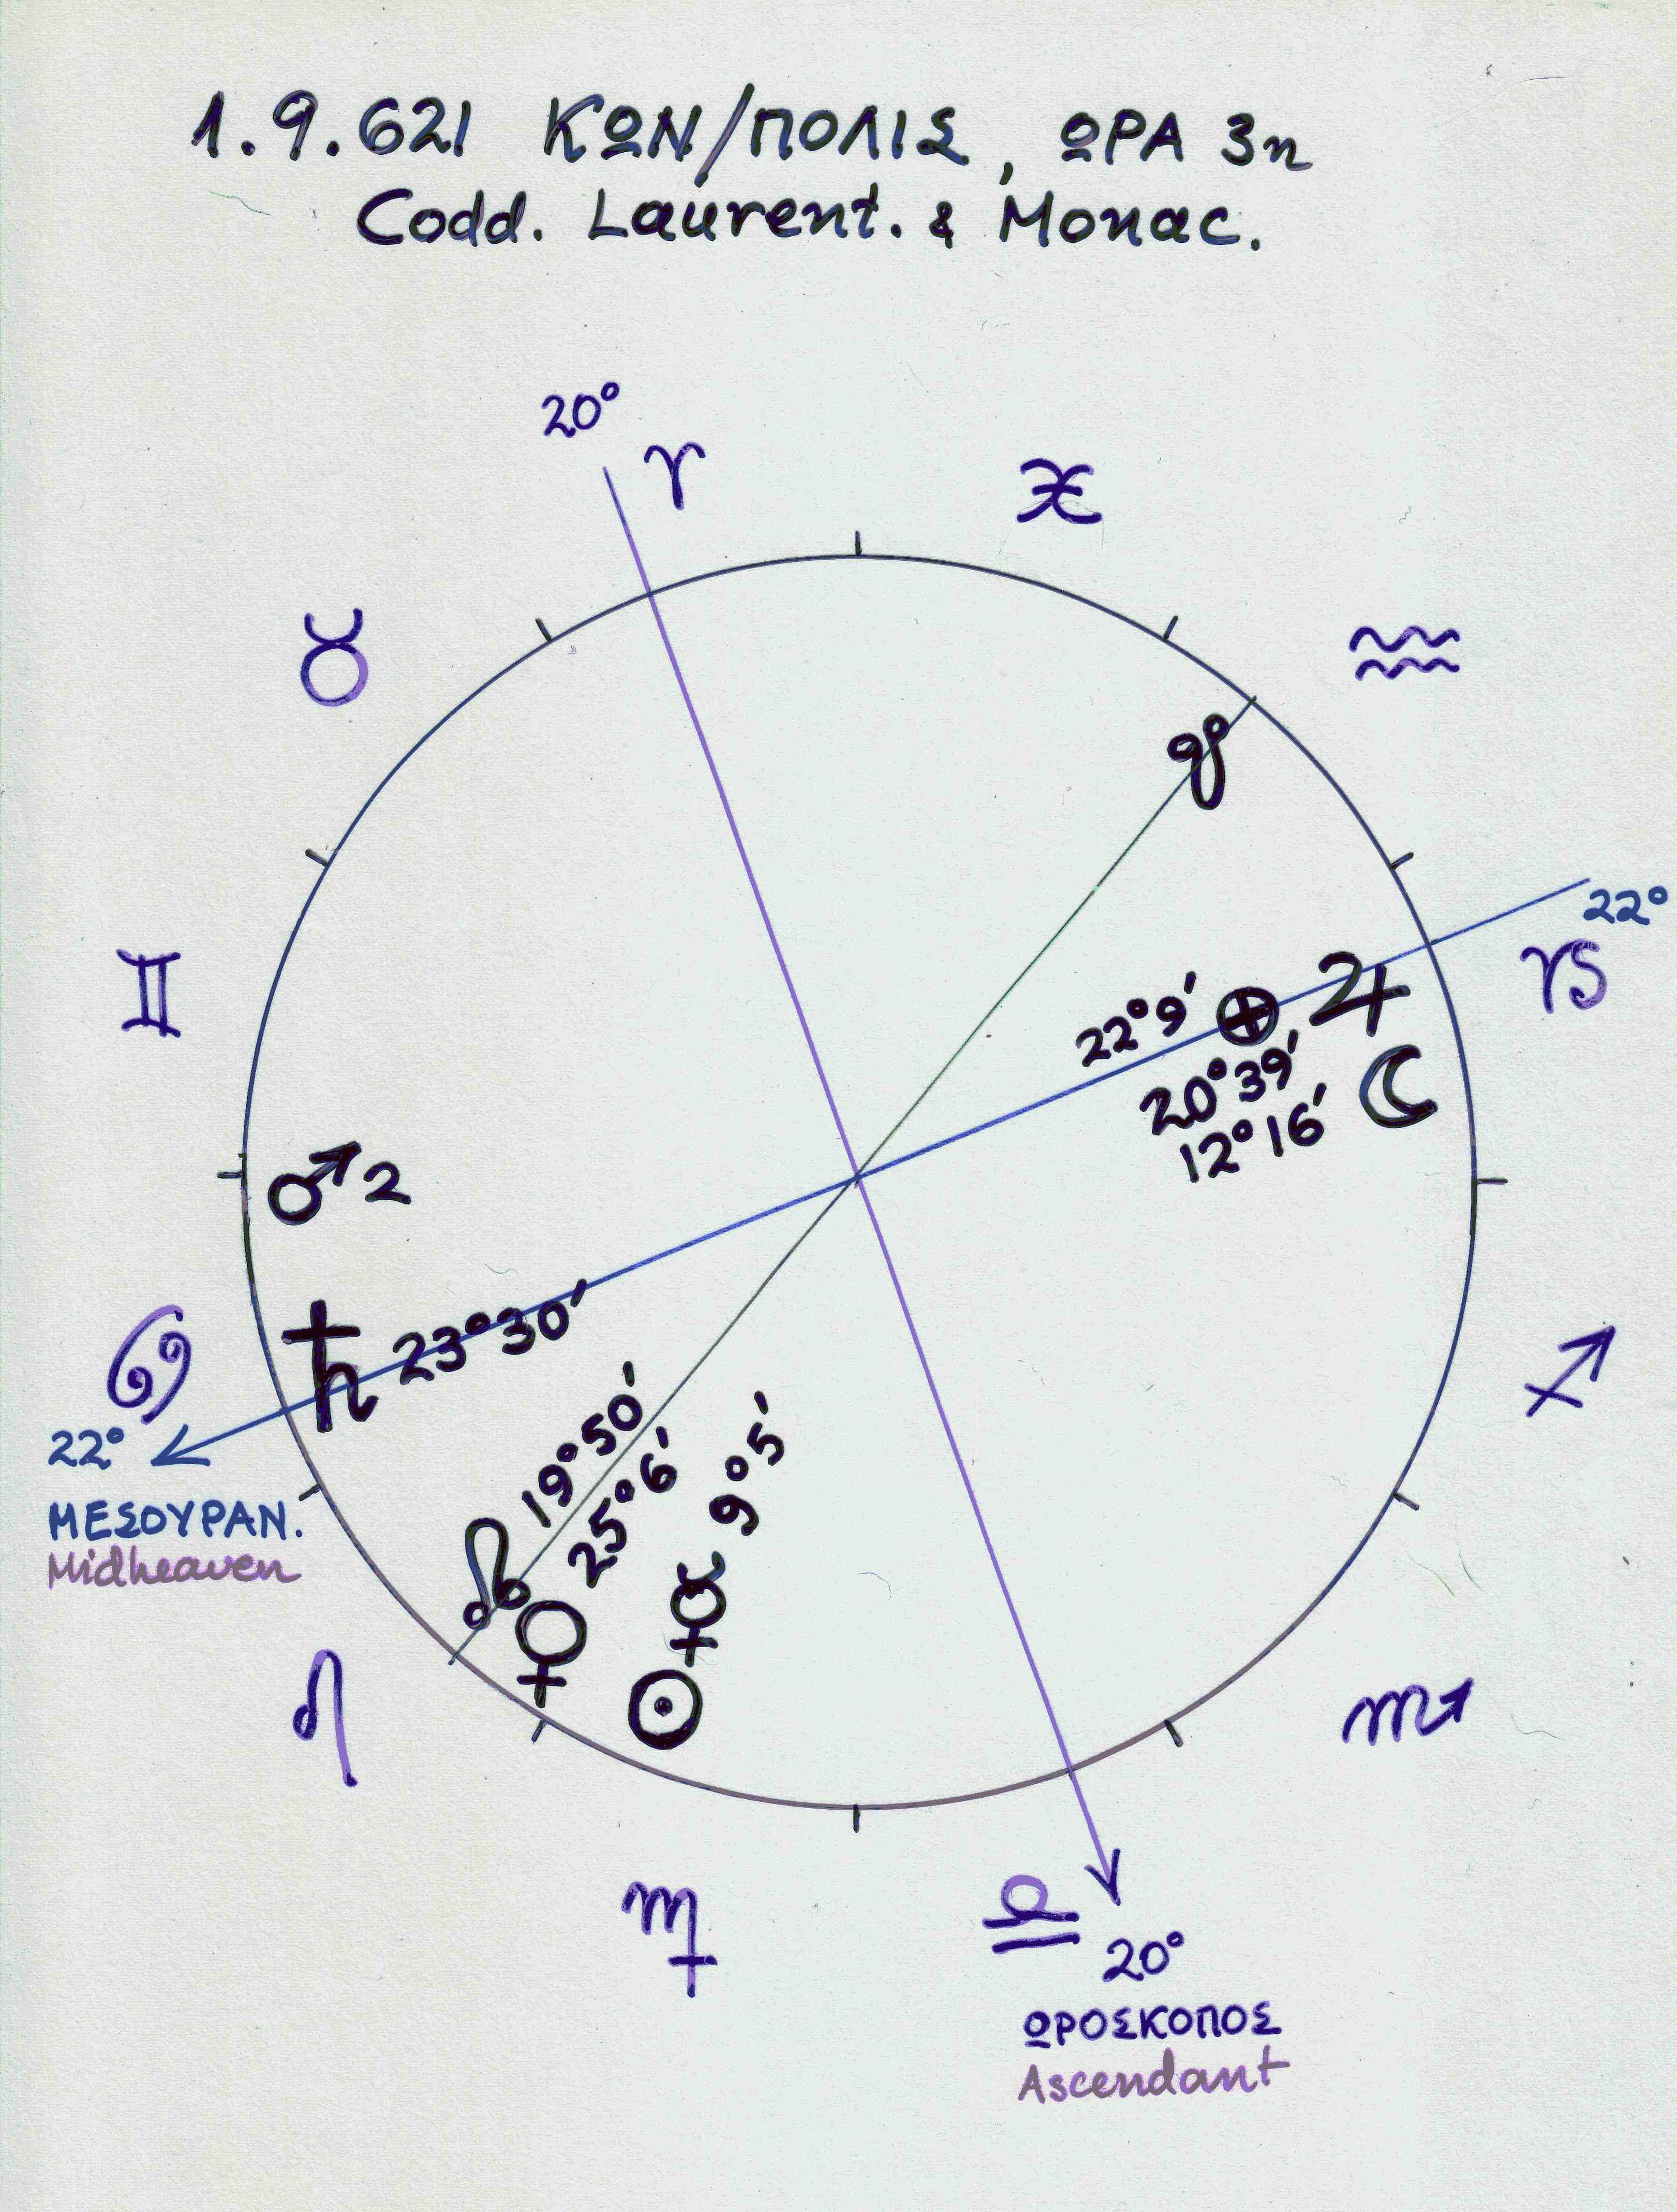
As reported in the text, the merchant Epiphanios visited Stephanos on Tuesday, 5 Thoth according to the Egyptians, in the third hour. ➢ 1.9.621, 8:55 am
The Sun and Mercury are in 9°5' Virgo in the 12th house.
The Moon is in 12°16' Capricorn in the 4th house.
Venus is in 26°6' Leo, in conjunction with
the Moon’s ascending node at 19°50' Leo, both in the 11th house.
Saturn is in 23°30' Cancer, in conjunction with the upper culminating point of the ecliptic in the 10th house.
Mars is in 2° Cancer in the 10th house.
Jupiter is in 20°39’ Capricorn, and the lot of fortune is in 22°9' Capricorn, in conjunction with the lower culmination.
The Moon’s descending node is in 19°50' Aquarius in the 5th house.

Slide 24
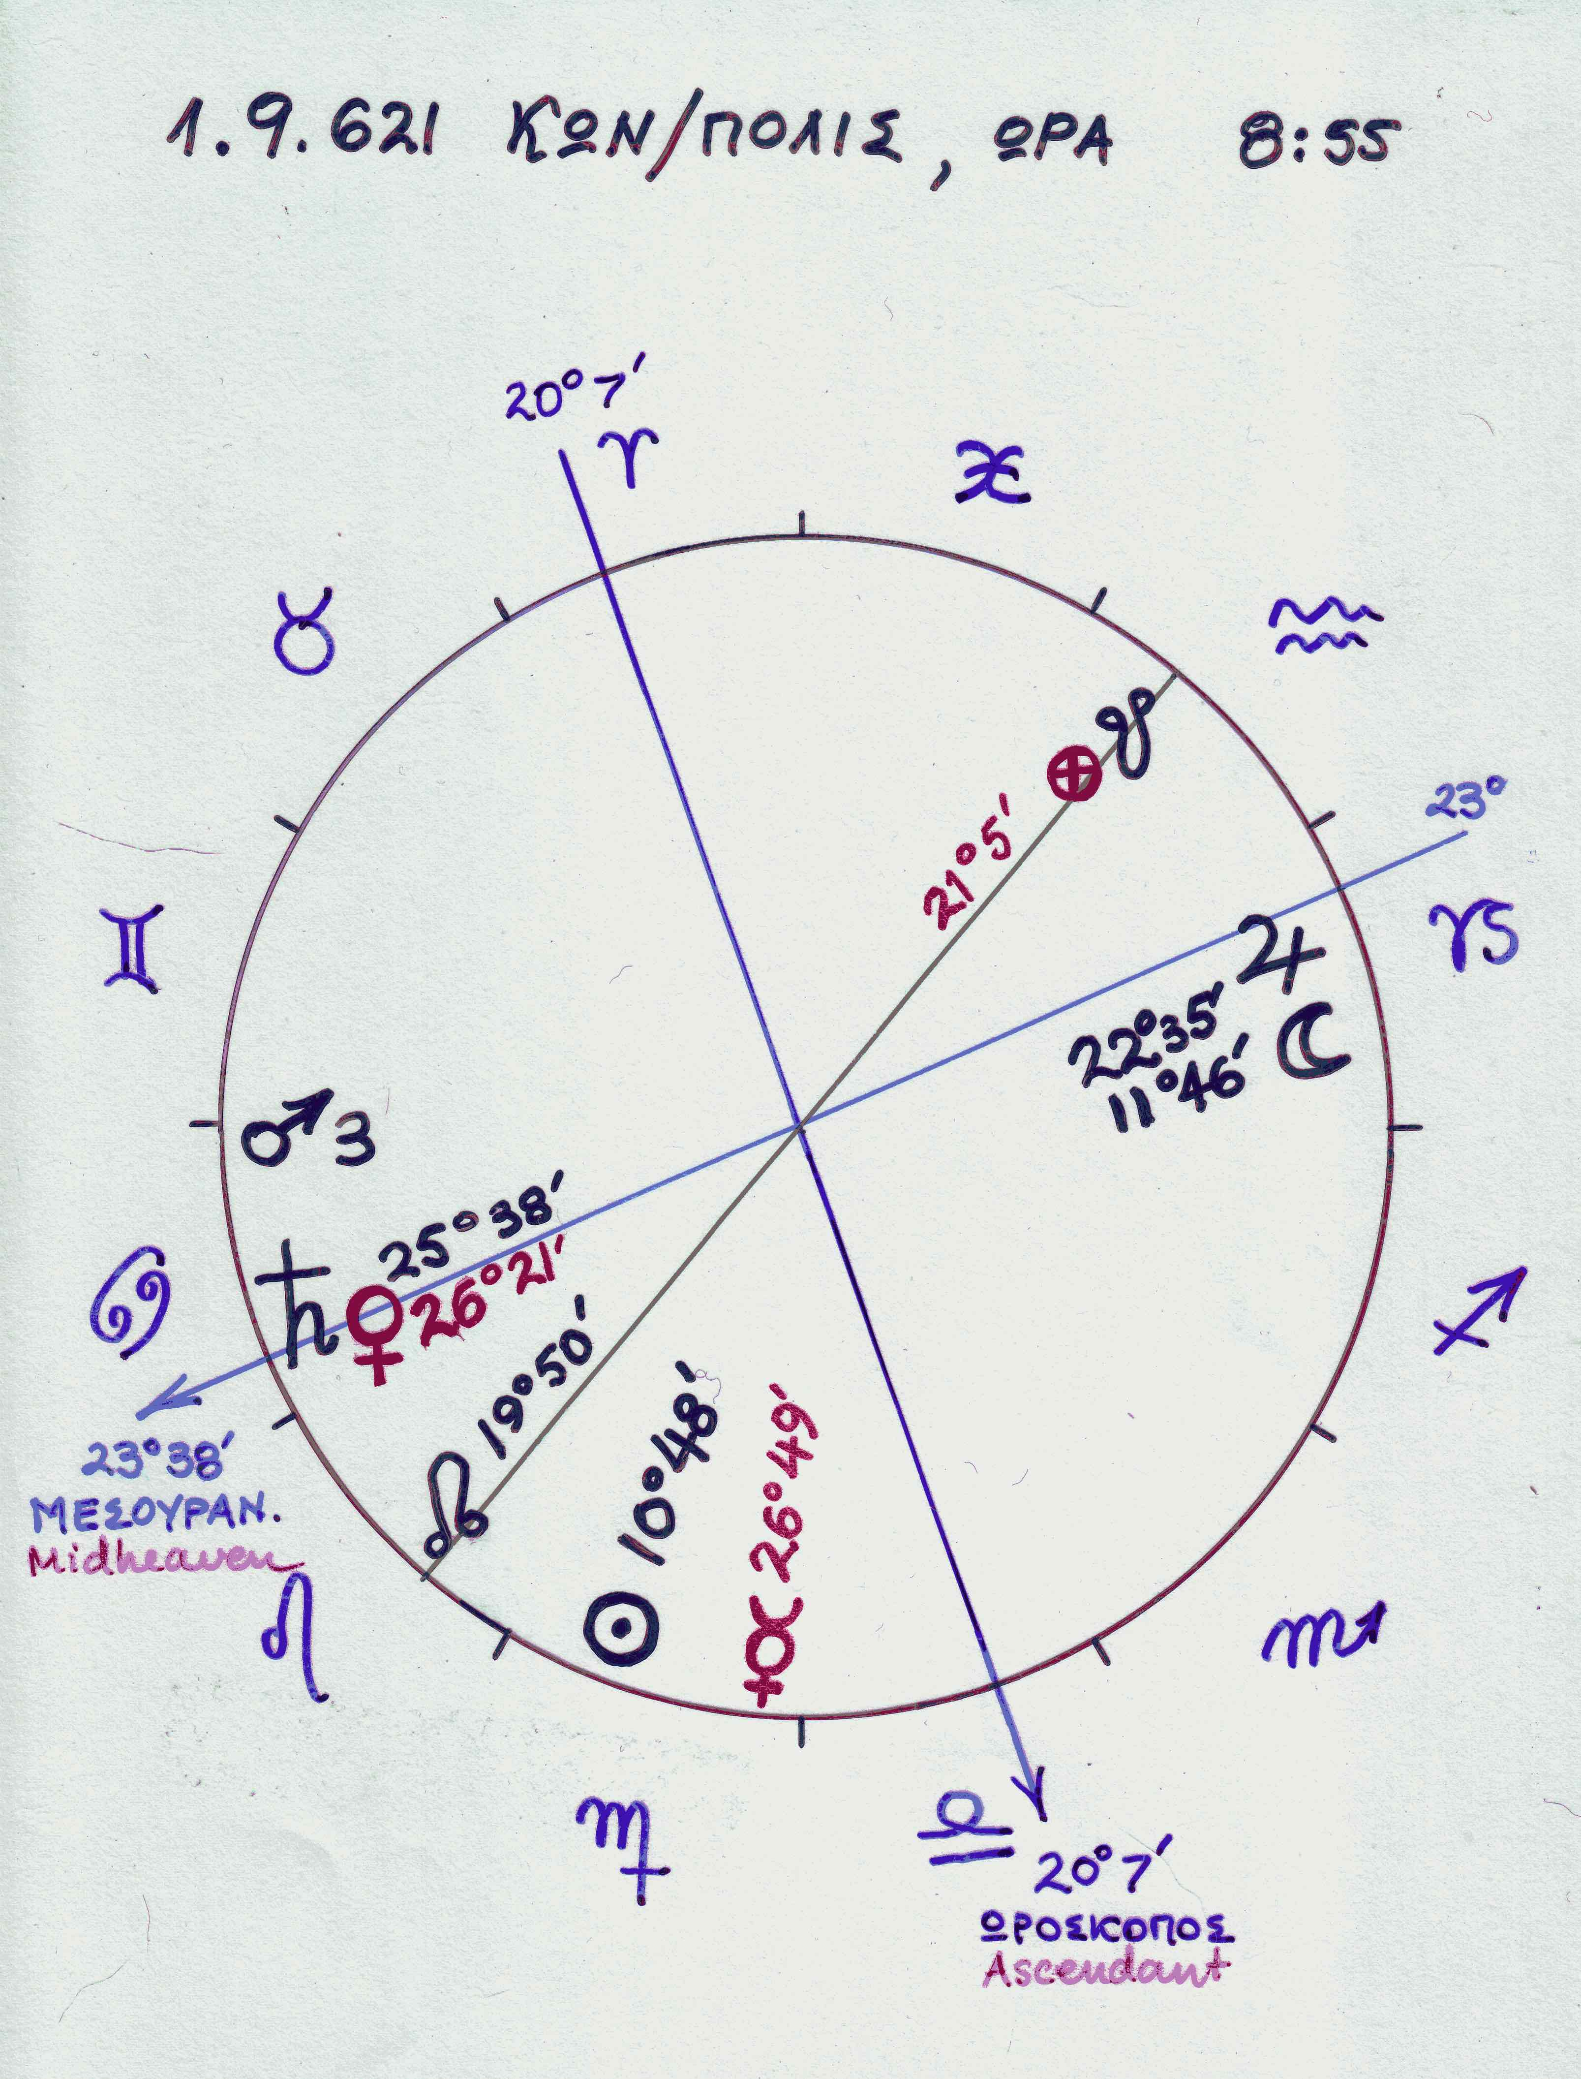
Regarding the errors in the positions of Venus, Mercury, and the lot of fortune found in the MSS, Usener, Neugebauer, and van Hoesen accept that those for Venus and the lot of fortune represent a misplacement of the data for the planetary positions into another sign in the diagram of the horoscope, while that for Mercury is a dittography of the Sun’s position.
Mars, Venus, and Saturn were visible in the morning sky, while the Moon and Jupiter were visible in the evening sky. Mercury was especially low in the west and set 16 minutes after sunset, when the Sun’s altitude was only 3°43' below the horizon.
Mercury was invisible because the twilight was still very bright. So whoever calculated the astronomical data for the horoscope of Islam was indeed observing the heavens on 1 September 621 and, because of Mercury’s invisibility, may have thought it was in exact conjunction with the Sun. As a result, he did not calculate its position using the relevant astronomical tables. This would account for the great difference of 16° between Mercury’s true position in the sky and that shown in the horoscope’s chart.

Slide 26
Identification of Sophronios
In Leimonarion, Moschos reports that with his friend, the sophist Sophronios, during their first residence in Alexandria between 581 and 584, attended lectures at the home of Stephanos, a sophist and philosopher who lived in the building complex around the church of the Holy Theotokos of Dorothea, built by the orthodox patriarch Eulogios. It seems that Stephanos, the teacher of Sophronios, is identical with Stephanos of Athens or Stephanos of Alexandria, physician and philosopher, the only teacher of medicine in Alexandria at that time. It seems also that Sophronios, the student of Stephanos in Alexandria, is the same Sophronios who later became patriarch of Jerusalem (634-38).
Stephanos’ close contacts with high-ranking officials of the three patriarchates, Alexandria, Constantinople, and Jerusalem, may explain the presence of prayers at the beginning and end of his lectures on alchemy. In addition, his medical and philosophical knowledge, as a known commentator on Hippocrates and Aristotle, may explain his references to medical and biological subjects in the alchemical work.
The author of the horoscope of Islam supposed that Sophronios, the friend of Moschos and patriarch Eulogios, had followed Stephanos from Alexandria to Constantinople and therefore could plausibly be placed in his teacher’s garden in September 621.

